Slide 1
Semiconductors & PN Junction
EE101: Lecture 2

Slide 2
Module 1: Analog Electronic Circuits
Contents:
Introduction
1. Semiconductor - Si
2. Two types of Charge carriers in Si
3. Enhancing the Si conductivity by doping in two ways
4. Two ways of Charge transport in Si
5. Formation of PN-junction (or Diode)
6. Study of PN-junction in its three states

Slide 3
Introduction
Electronic Circuits: Circuits containing Semiconductor devices like Diode, Transistors etc., in addition to R, L, C.
Analog Electronic Circuits: All the sources (or signals) in the circuits have continuous values between its two extremes.
Objective of Module 1: Analysis of Analog Circuits
Major Analysis Step: Diodes and Transistors are replaced by their linear Model
Model: Circuit with sources and R, C which behaves as the actual circuit.
Tools: KVL and KCL (Nodal/Mesh Analysis. Superposition Theorem)

Slide 4
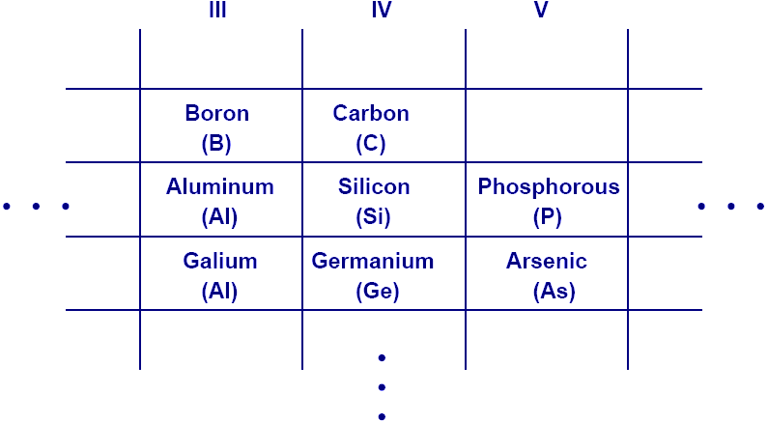
1. Semiconductor - Si
This abridged table contains elements with three to five valence electrons, with Si being the most important.

Slide 5
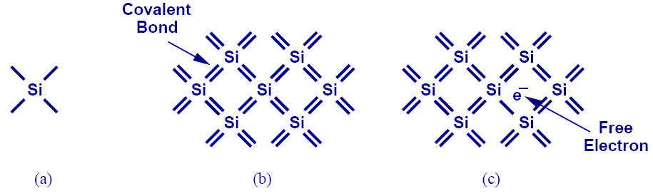
2.1 Silicon Charge Carrier - Electrons
Si has four valence electrons. Therefore, it can form covalent bonds with four of its neighbors.
When temperature goes up, electrons in the covalent bond can become free.

Slide 6
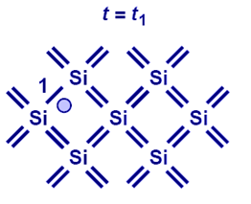
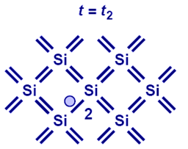
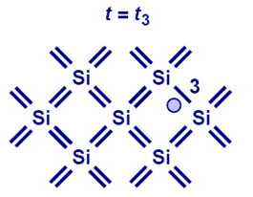
2.2 Silicon Charge Carrier - Hole
With free electrons breaking off covalent bonds, holes are generated.
Holes can be filled by absorbing other free electrons, so effectively there is a flow of charge carriers.

Slide 7
Free Electron Density at a Given Temperature
E_{g}, or bandgap energy determines how much effort is needed to break off an electron from its covalent bond.
There exists an exponential relationship between the free-electron density and bandgap energy.
5x10^22 Silicon atoms per cubic cm

Slide 8
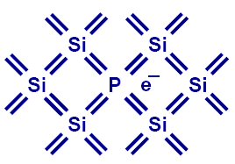
3.1 Doping (N type)
Pure Si can be doped with other elements to change its electrical properties.
For example, if Si is doped with P (Phosphorous), then it has more electrons, or becomes type N (electron).

Slide 9
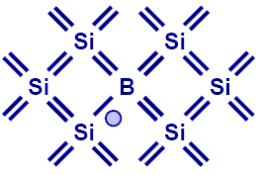
3.2 Doping (P type)
If Si is doped with B (Boron), then it has more holes, or becomes type P.

Slide 10
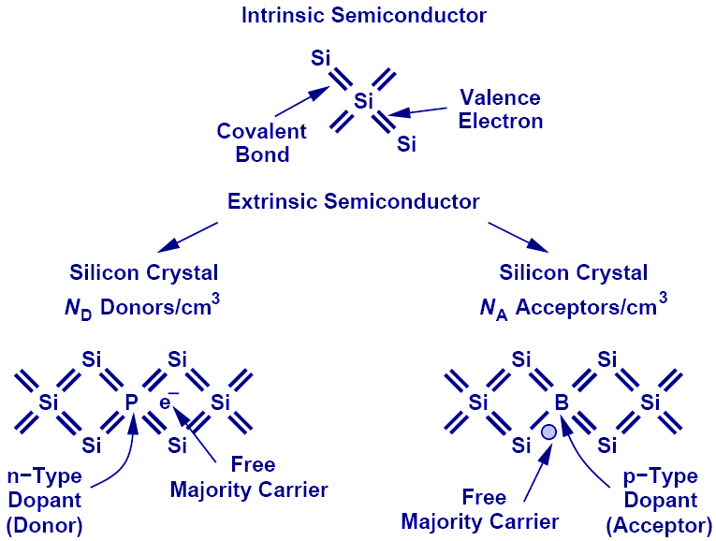
Summary of Charge Carriers

Slide 11
Electron and Hole Densities
Majority Carriers :
Minority Carriers :
Majority Carriers :
Minority Carriers :
The product of electron and hole densities is ALWAYS equal to the square of intrinsic electron density regardless of doping levels.

Slide 12
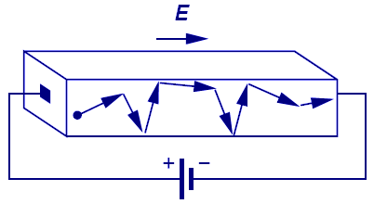
4.1 First Charge Transportation Mechanism: Drift
The process in which charge particles move because of an electric field is called drift.
Charge particles will move at a velocity that is proportional to the electric field.

Slide 13
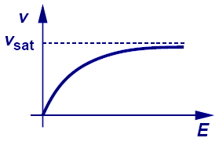
Velocity Saturation
In reality, velocity does not increase linearly with electric field. It will eventually saturate to a critical value.

Slide 14
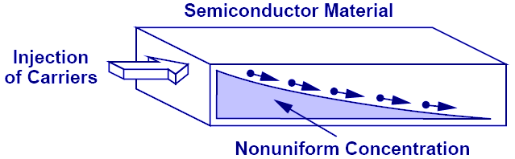
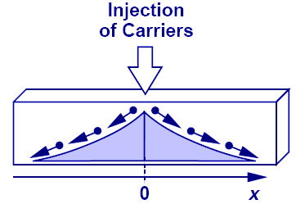
4.2 Second Charge Transportation Mechanism: Diffusion
Charge particles move from a region of high concentration to a region of low concentration. It is analogous to an every day example of an ink droplet in water.

Slide 15
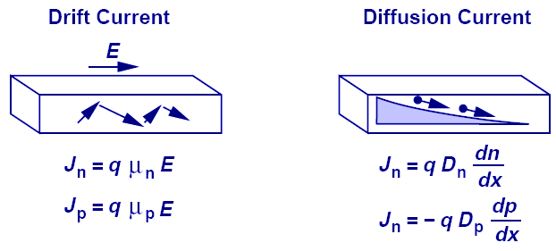
Einstein's Relation
While the underlying physics behind drift and diffusion currents are totally different, Einstein’s relation provides a mysterious link between the two.

Slide 16
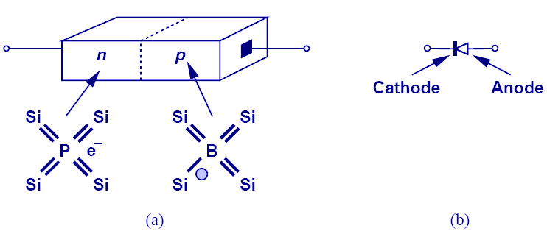
5. PN-Junction (Diode)
When N-type and P-type dopants are introduced side-by-side in a semiconductor, a PN junction or a diode is formed.

Slide 17
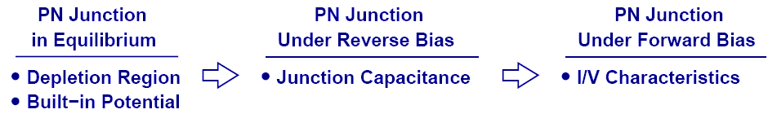
6. Diode’s Three Operation Regions
In order to understand the operation of a diode, it is necessary to study its three operation regions: equilibrium, reverse bias, and forward bias.

Slide 18
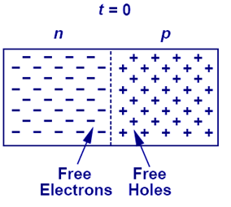
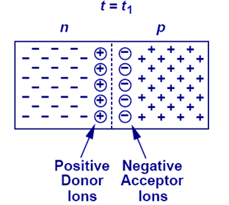
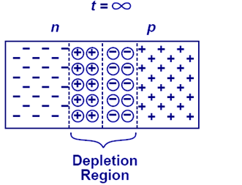
6.1 Depletion Region
As free electrons and holes diffuse across the junction, a region of fixed ions is left behind. This region is known as the “depletion region.”

Slide 19
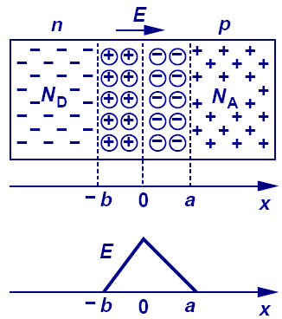
Current Flow Across Junction: Drift
The fixed ions in depletion region create an electric field that results in a drift current.

Slide 20
Built-in Potential
Because of the electric field across the junction, there exists a built-in potential.

Slide 21
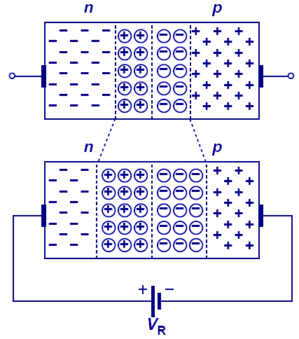
6.2 Diode in Reverse Bias
When the N-type region of a diode is connected to a higher potential than the P-type region, the diode is under reverse bias, which results in wider depletion region and larger built-in electric field across the junction.

Slide 22
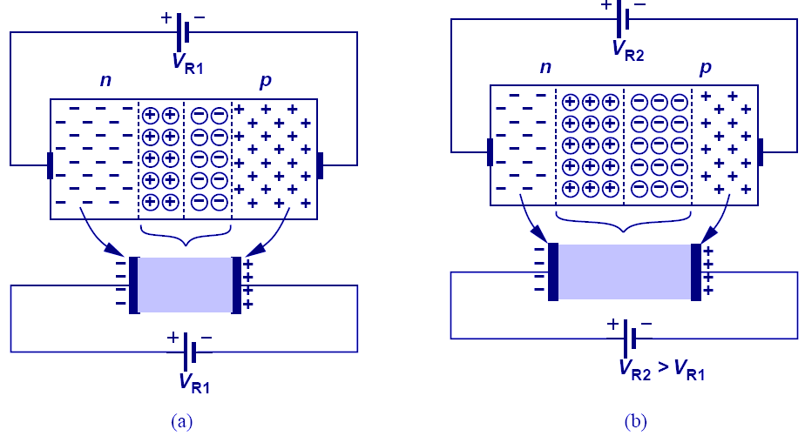
Reverse Biased Diode’s Application: Voltage-Dependent Capacitor
The PN junction can be viewed as a capacitor. By varying V_{R}, the depletion width changes, changing its capacitance value; therefore, the PN junction is actually a voltage-dependent capacitor.

Slide 23
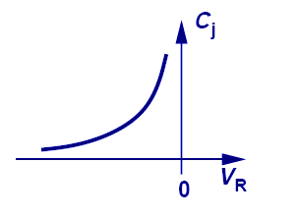
Voltage-Dependent Capacitance
The equations that describe the voltage-dependent capacitance are shown above.

Slide 24
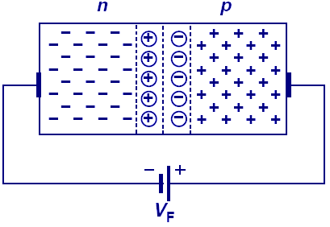
6.3 Diode in Forward Bias
When the N-type region of a diode is at a lower potential than the P-type region, the diode is in forward bias.
The depletion width is shortened and the built-in electric field decreased.

Slide 25
Reference
Fundamentals of Microelectronics by Behzad Razavi, Ch2 and Ch3

